Slide 1
CSS Stylin’
Chris Human ©2023

Slide 2
Know Thyself
You should…
Be comfortable with the basics of Terminal, Git/GitHub, & HTML.
Be able to completely write the minimum requirements of an HTML document without looking at references.

Slide 3


HTML / CSS Definitions (*yawn*)
HTML: Hypertext Markup Language – (Content)
CSS: Cascading Style Sheets – (Appearance)
HTML/CSS are the “languages of the web.” Together they define both the content and the aesthetics of a webpage – handling everything from the layouts, colors, fonts and content placement.

Slide 4


HTML / CSS Analogy
HTML Alone
Like writing papers in “Notepad.”
Can only write unformatted text.
HTML / CSS
Like writing papers in Microsoft Word.
Can format text, page settings, alignment, etc. based on “highlighting” and menu options.

Slide 5
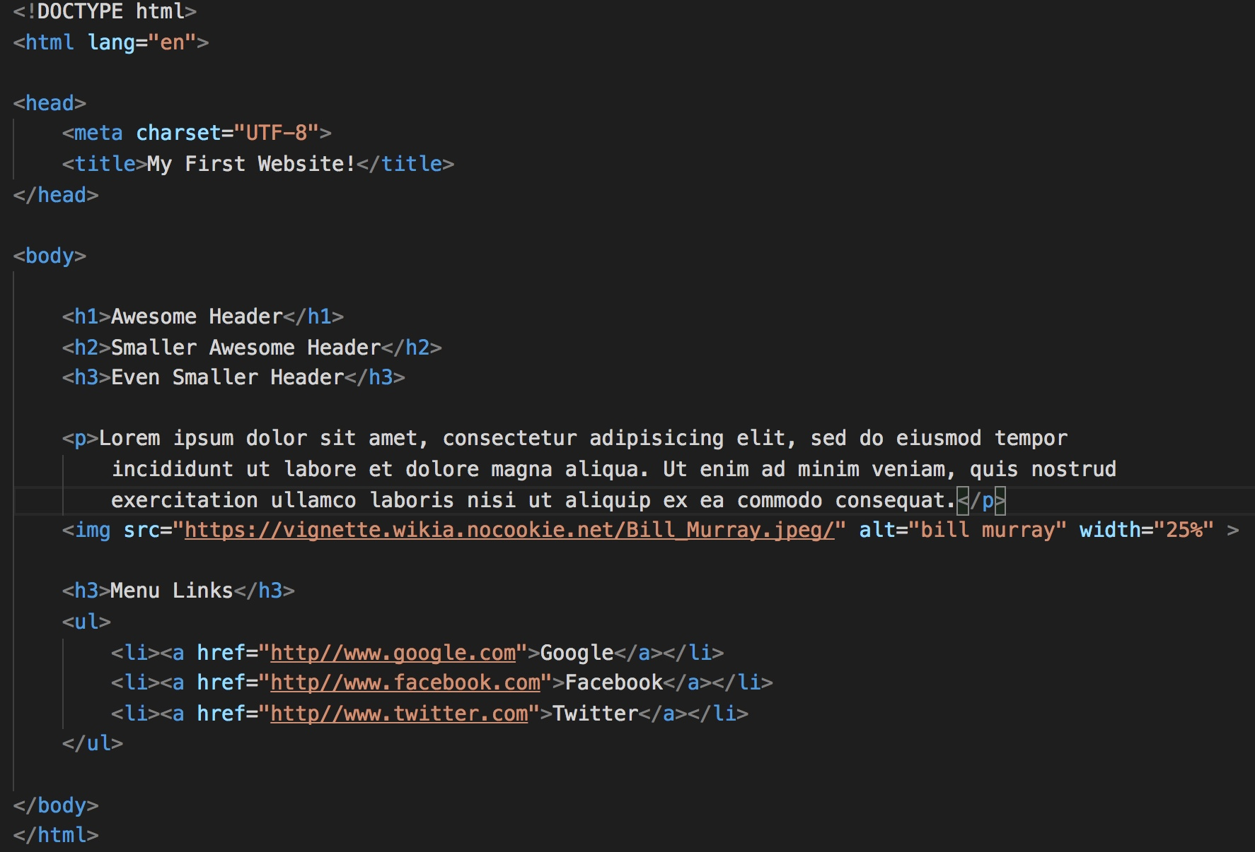
Basic HTML Page

Slide 6

Basic HTML Page - Result
Hella Boring…

Slide 7
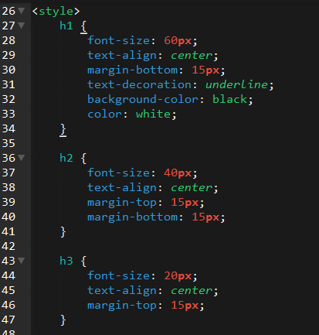
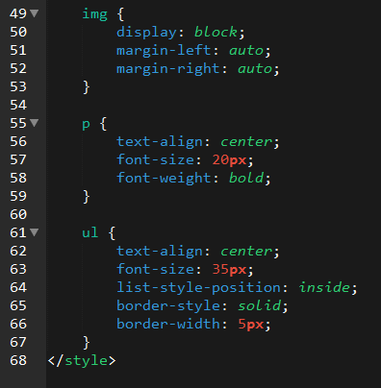
Enter CSS

Slide 8

Enter CSS - Result

Slide 9

CSS Syntax
CSS works by hooking onto selectors added into HTML using classes and identifiers.
Once hooked, we apply styles to those HTML elements using CSS.

Slide 10
CSS Example
In the below example the header would be turned blue and MUCH larger because of the CSS.
We can incorporate an element’s class or ID to apply a CSS style to a particular part of the document.
Just remember to include the necessary symbol before the CSS: “.” for class, “#” for ID.
Example (HTML):
<h1 class=“bigBlue”>Header</h1>
Example (CSS):
.bigBlue {
font-size: 100px;
color: blue;
}

Slide 11
Selectors
Applies to all <p> elements
p {
background-color: blue;
}
Applies to all elements with class=“classItem"
.classItem {
background-color: orange;
}
Applies to all elements with id=“idItem"
#idItem {
background-color: green;
}
Element selector
Element name
(p, a, div, span, etc)
Class Selector
Period (.) + variable name
(.myDiv, .phoneNumber, etc.)
ID Selector
Hash (#) + variable name
(#myDiv, #phoneNumber)

Slide 12
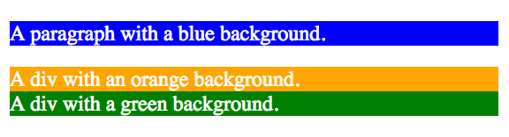
Selectors continued…
p {
background-color: blue;
}
.classItem {
background-color: orange;
}
#idItem {
background-color: green;
}
<p>
A paragraph with a blue background.
</p>
<div class=“classItem">
A div with an orange background.
</div>
<div id=“idItem">
A div with a green background.
</div>
+

Slide 13
Key CSS Attributes
Font / Color:
color: Sets color of text.
font-size: Sets size of the font.
font-style: Sets italics.
font-weight: Sets bold.
Alignment / Spacing:
padding (top/right/bottom/left): Adds space between element and its own border.
margin (top/right/bottom/left): Adds space between element and surrounding elements.
float: Forces elements to the sides, centers, or tops.
Background:
background-color: sets background color.
background-image: sets background image.

Slide 14
Demo

Slide 15
Relative File Paths

Slide 16
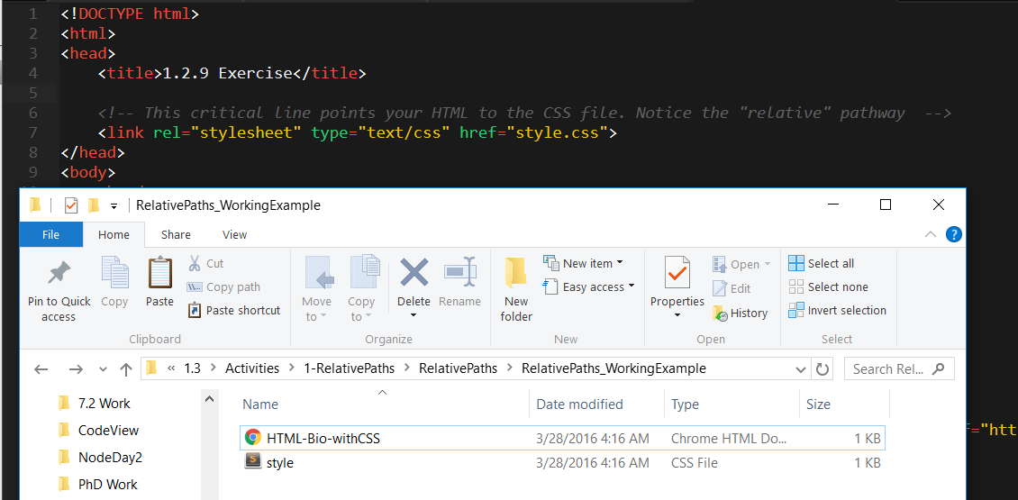
Relative File Paths
Relative file paths connect us with other files in our working directory. In this case, style.css is in the same folder as our html document.

Slide 17
Demo

Slide 18
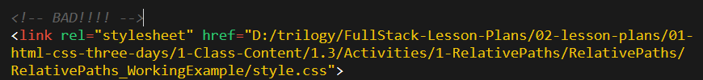

Absolutely No Absolute Paths
VERY VERY BAD
ALWAYS USE RELATIVE FILE PATHS.
If you deploy your sites without them, all of your links will fail.
The same will happen if you move your project from one folder to another.
Remember, there is no such thing as a “C:” drive on the internet.

Slide 19
Your Turn!
Activity: Relative Paths
Suggested Time: 10 min.
Assignment:
Unzip the folder sent to you
Edit the HTML files. You need to write the relative path to link the CSS file to the HTML file.
Only modify the HTML files! Do NOT move or modify the CSS files.

Slide 20
Box Model

Slide 21
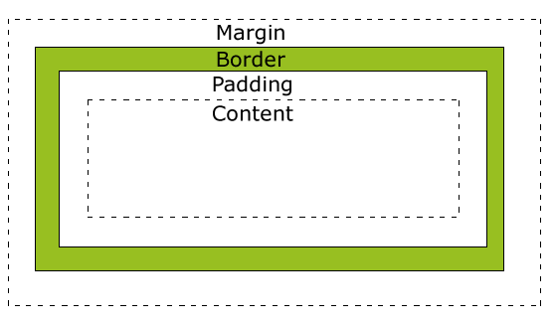
Boxes Upon Boxes
In CSS, every element rests within a series of boxes.
Each box has customizable space properties:
margin, border, and padding.
Typical spacing value: 20px 10px 10px 20px (top, right, bottom, left)

Slide 22
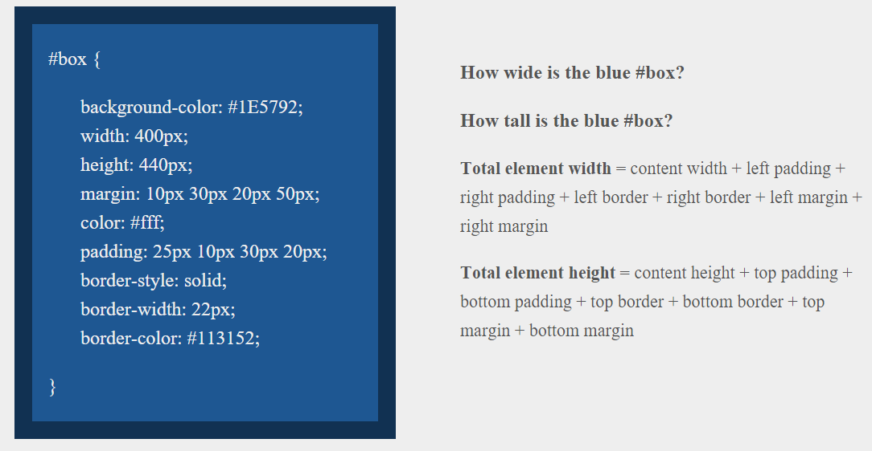
Your Turn!
Answer
Width: 554 px
Height: 569 px

Slide 23
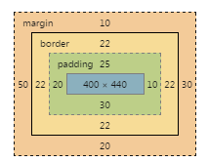
Your Turn!
Answer
Width: 554 px
Height: 569 px

Slide 24
We Be Floatin’

Slide 25
Warning!
These next things can be tricky and will HAVE to be reviewed more outside of class

Slide 26

The Concept of “Flow”
By default, every HTML element displayed in the browser is governed by a concept called flow.
This means that HTML elements force their adjacent elements to flow around them.

Slide 27
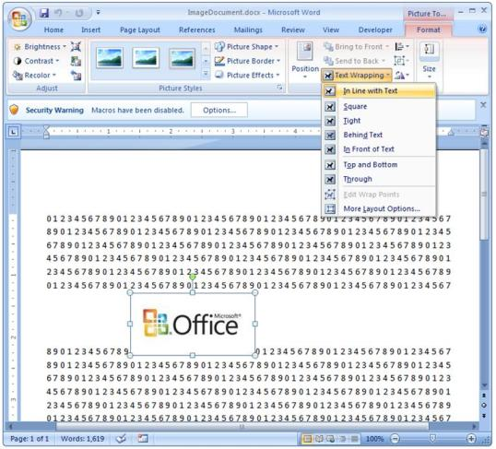
“Flow” in MS Word
This concept of “flow” is very similar to the wrap-text options you may be familiar with in Microsoft Word.
Just as in MS Word, you can have images in-line with text, on-top of text, etc.

Slide 28
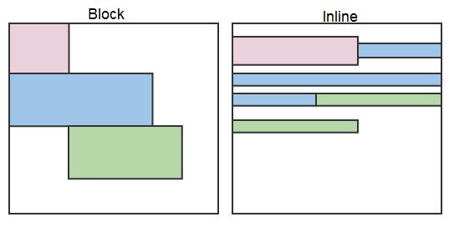
Block Elements
By default, web clients render many HTML elements as block elements. Paragraphs, headers, divs and more receive this treatment.
A block element will take up an entire line of space—unless you intervene with CSS properties.

Slide 29
Block vs Inline Elements
Now contrast the block elements with inline elements.
By using float CSS properties, we can command our website to display multiple HTML elements adjacently.

Slide 30
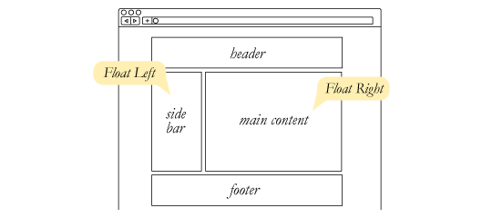
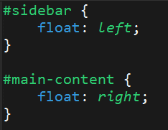
Floating
To transform these block elements into inline elements, we use a CSS property called float.
Floats are necessary for building web layouts.

Slide 31
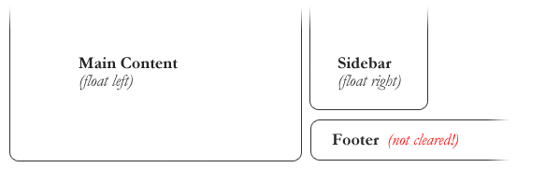
Clearing the Float
Floats often get in the way of our layouts.
Sometimes we don’t want to give each element the “inline” treatment.

Slide 32
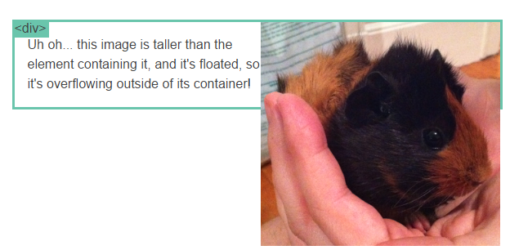
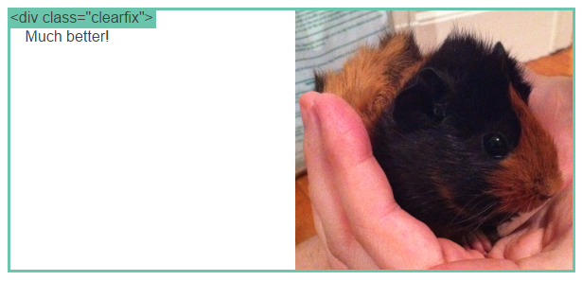
Clearfix Hack
Sometimes when elements don’t match up in size, we get situations like the above…
We can get around this by using “the clearfix hack.”

Slide 33
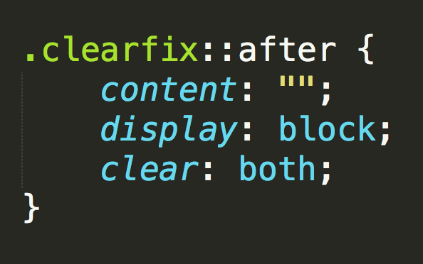
Clearfix Hack
::after is what we call a pseudo-element. We use it to style specific parts of an element.
This will add an HTML element, hidden from view, after the content of the “.clearfix” element. This clears the float.

Slide 34

Quick Demo

Slide 35
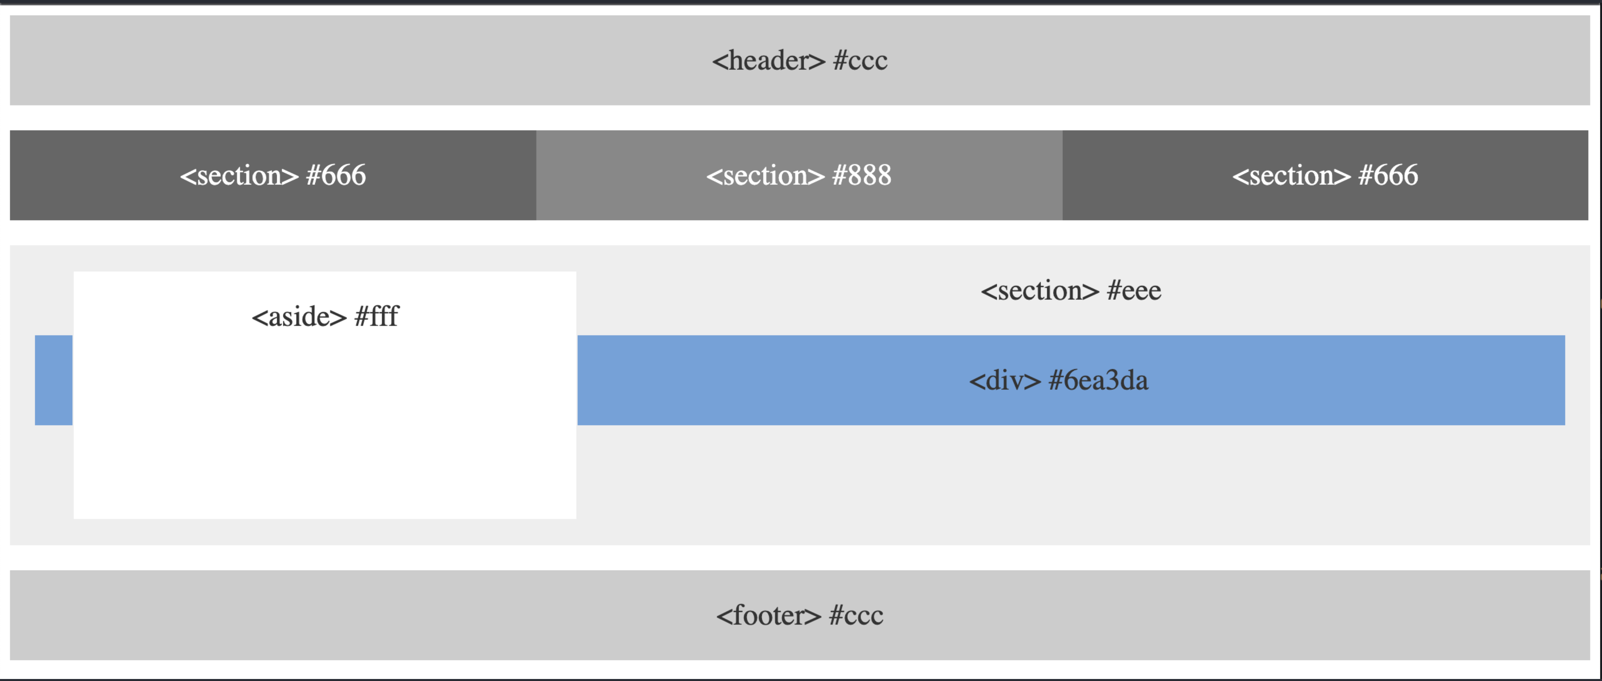
Your Turn!
Activity: Floatin’ Layout
Suggested Time: 25 min.
Assignment:
Use the provided HTML and CSS files to replicate the layout shown in the image.

Slide 36

Great work!

Slide 37
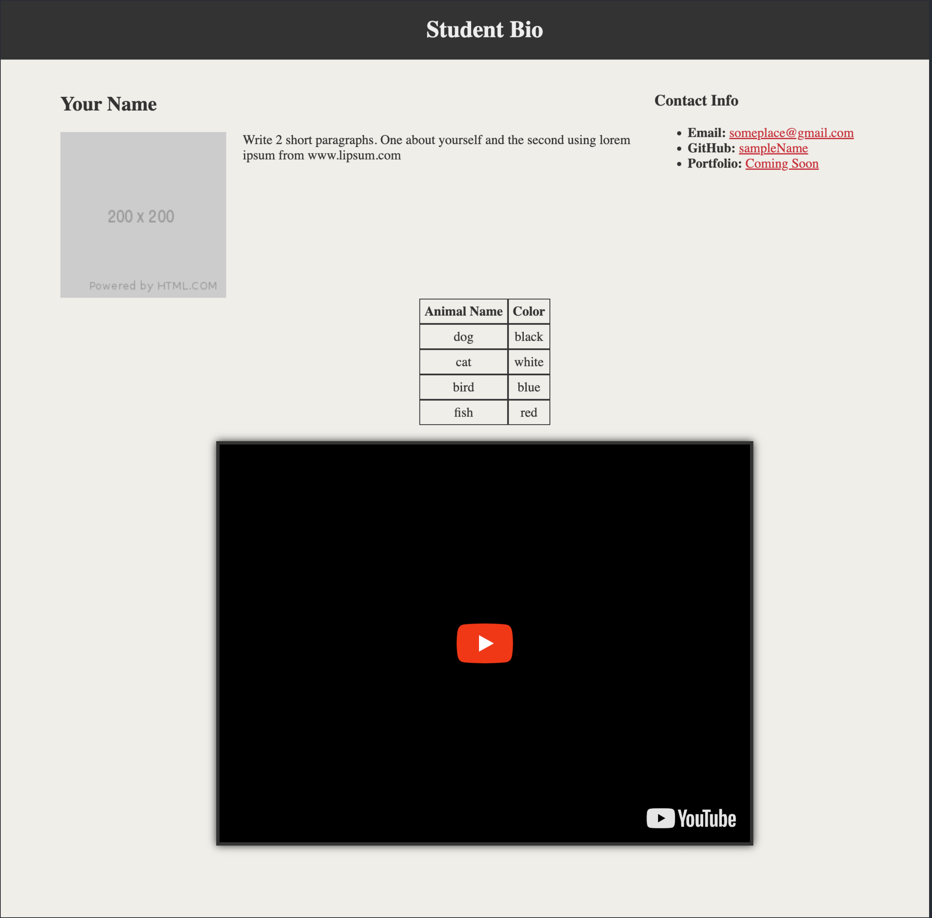
Your Turn!
Activity: Student Bio + CSS
Suggested Time: 20 min.
Assignment:
Upgrade your previous HTML student-bio page using CSS style rules to match the image below.
Add, commit, and push your changes to your GitHub repository

